Slide 1
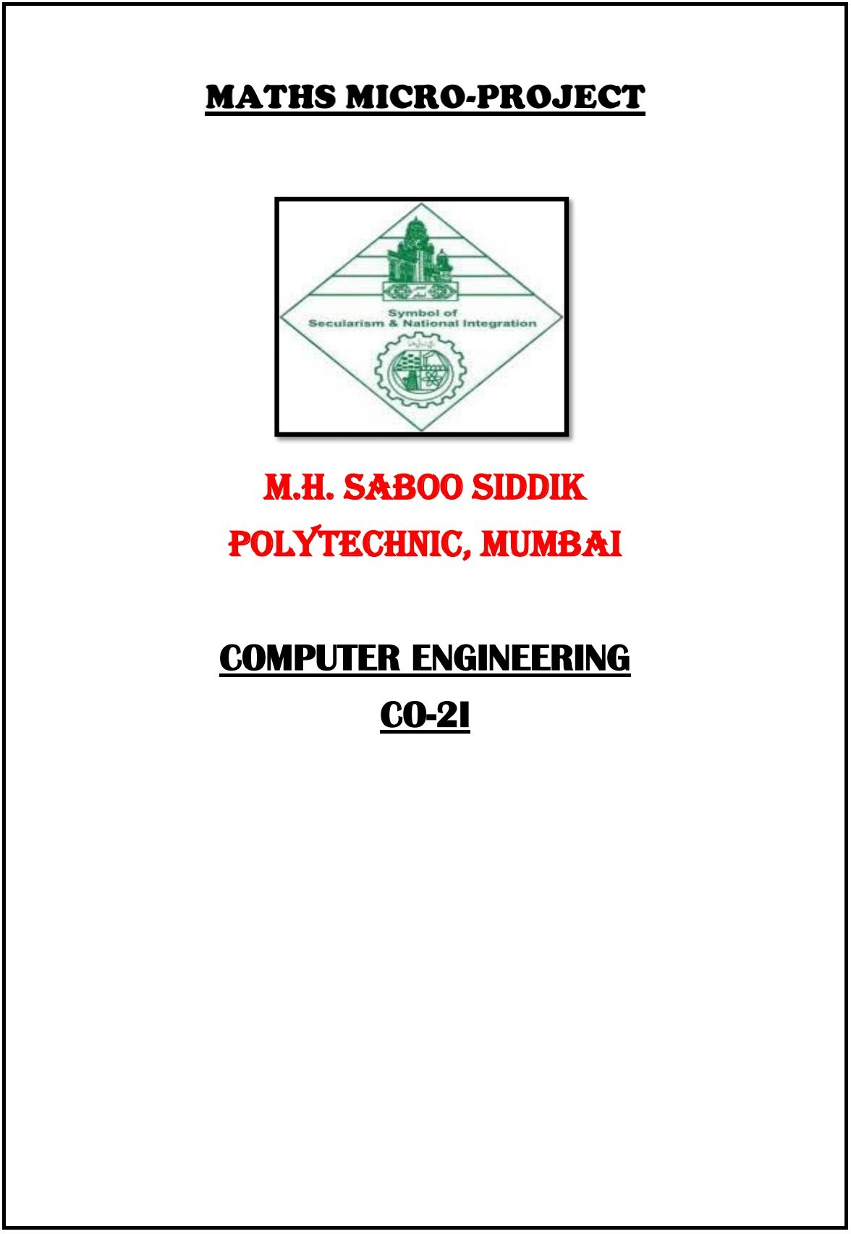

Slide 2
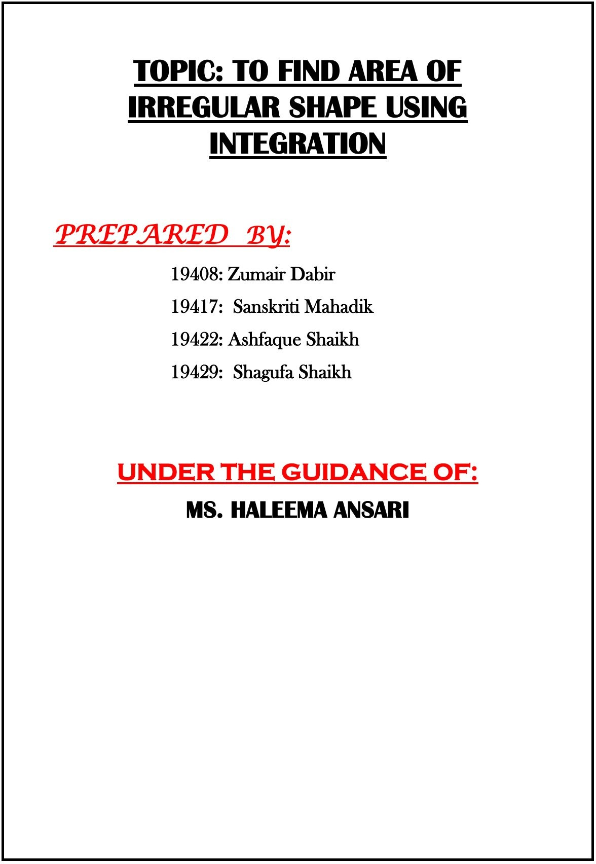
TOPIC: NEWTON’S LAW OF COOLING
210451 Abdurrahman Qureshi
210452 Welder Umme Hafsa
210452 Saad Ansari
210454 Shaikh Azlan Ahmed
210455 Oaish Qazi

Slide 3
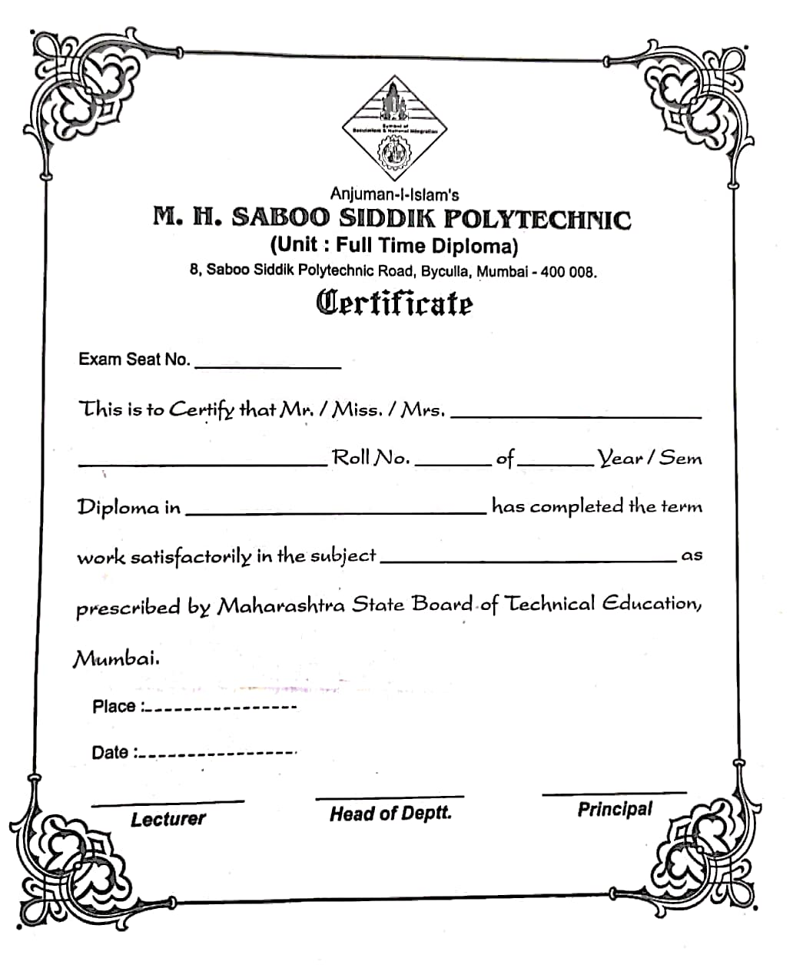

Slide 8
Annexure-I
Micro-Project Proposal:
Newton's law of cooling.
Aims/Benefits of Micro-Project:
Learnt the Newton's law of cooling.
To understand Newton's law of cooling.
2. Course outcomes Addressed:
Solve the differential equation of first order and first degree using suitable methods
Proposed methodology:
Discussion of the given topic among group members.
Distribution of work.
Submission of project proposal.
Analysis of data collected.
Work divided among group members
Compilation of content
Representation
Editing the content as per the instructions
Report Preparation
Viva and presentation

Slide 9
4. Action plan (sequence and time required for activity)
Weeks | Details of activity | Planned start date | Planned finish date | Name of responsible team members
₁st | Discussions & finalization of topics
₂nd | Preparation of Data
₃rd | Data review
₄th & ₅th | Collection of data
₆th _{& 7}th | Discussion of outline of content
₈th & ₉th | Formation of content
₁₀th | Editing & proof reading of content
₁₁ | Compilation of report & preparation
12 | Final submission
13 | Viva

Slide 10
5. Resources required(major resources such as raw materials, some machining facility,software,etc.)
Sr. no. | Name of resources | Specifications | Qty | Remarks
1. | Online | Learning resources and various websites | 5 sites | -
2. | Desktop | Microsoft word, Microsoft Powerpoint, Tools with internet facility. | 1 for each | -
3. | Printer | Inkjet/Laser | 1 | -
4. | Stationary | Papers, Spiral binding,etc. | 40-50 pages | -
Participants:
Name | Roll No | Enrollment No
Abdurrahaman Qureshi | 210451 | 2100020112
Hafsa Umme Welder | 210452 | 21000
Saad Ansari | 210453 | 21000
Azlan Ahmed Shaikh | 210454 | 21000093
Oaish Qazi | 210455 | 21000108

Slide 11
Annexure-II
Micro-project proposal PART-A
Aims/Benefits of the microproject:
The aim of the microproject is to study about Newton’s law of Cooling.
Course outcomes addressed:
Solve the differential equation of first order and first degree using suitable methods
Proposed methodology
The topic was assigned to us by our respective faculty.
Each group member was assigned work.
The information was gathered from different sources.
After the resources were gathered, compilation was done and a booklet was prepared.
After completing the micro project report was prepared
along with the annexures (Format provided by faculty).
After the micro project report, weekly report was drafted in which week wise work was noted.
From 1st to 12th week.
And we Completed our:
Micro project
Weekly report
Annexure 1 and 2
Rationale:
Newton’s law of cooling states that the rate of heat loss from a body is directly proportional to the difference in temperature between the body and its surroundings. Using Newton’s rule of cooling, we can determine how quickly a substance at a given temperature will cool in any given environment.

Slide 12
Aims and benefits for this Micro Project: Newton's Law of Cooling is useful for studying water heating because it can tell us how fast the hot water in pipes cools off. A practical application is that it can tell us how fast a water heater cools down if you turn off the breaker when you go on vacation. Course Outcomes Achieved: Solve the differential equation of first order and first degree using suitable methods. Literature Review: Isaac Newton published his work on cooling anonymously in 1701 as "Scala graduum Caloris. Calorum Descriptiones & signa" in Philosophical Transactions, volume 22, issue 270. Newton's law of cooling states that the rate of heat loss of a body is directly proportional to the difference in the temperatures between the body and its environment.

Slide 13
Definition: The law is frequently qualified to include the condition that the temperature difference is small and the nature of heat transfer mechanism remains the same. As such, it is equivalent to a statement that the heat transfer coefficient, which mediates between heat losses and temperature differences, is a constant. This condition is generally met in heat conduction (where it is guaranteed by Fourier's law) as the thermal conductivity of most materials is only weakly dependent on temperature. In convective heat transfer, Newton's Law is followed for forced air or pumped fluid cooling, where the properties of the fluid do not vary strongly with temperature, but it is only approximately true for buoyancy-driven convection, where the velocity of the flow increases with temperature difference. Finally, in the case of heat transfer by thermal radiation, Newton's law of cooling holds only for very small temperature differences.

Slide 14
REPORT
PART-B: Final Report Title: Report on Newton’s law of Cooling
1. Rationale/Importance of micro project:
It helps us to know about what are Newton’s Law of cooling, its purpose, description was studied in detail.
Aims of the microproject:
Solve the differential equation of first order and first degree using suitable methods
Understanding Newton’s law of cooling
Course outcomes achieved:
Formulate grammatical correct sentences.
Summarize reports
Use relevant words as per the context
Deliver prepared PPT to express information about Newton’s Law of cooling.
4.Links :
Byjus : https://byjus.com/jee/newtons-law-of-cooling/
Carolina : https://www.carolina.com/teacher-resources/Interactive/newtons-law-of-cooling/tr36401.tr
Protons Talk : https://protonstalk.com/thermal-properties-of-matter/newtons-law-of-cooling/

Slide 15
6. Actual resource used:
Sr. no. | Name of resources | Specifications
1. | Online | Learning resources and various websites
2. | Desktop | Microsoft word, Microsoft Powerpoint, Tools with internet facility.
3. | Printer | Inkjet/Laser
4. | Stationary | Papers, Spiral binding,etc.
Outputs of the microproject:
Newton’s law of cooling was bought to us.
Skills developed during the microproject:
Designing- Designing microproject with minimum required resources and at low cost.
Teamwork- Learning to work in team and boost individual confidence.
Time management- Completion of microproject as scheduled.
Technical writing- Preparing a report of proposed plan and report.
9. Applications of microproject:
The microproject helped us improve our knowledge about Newton’s law of cooling.

Slide 16
Annexure-III
Evaluation sheet for the micro project
Academic year: 2021-22
Name of faculty: Ms. Halima Ansari
Course: AMI
Course Code: 22224
Semester: 2nd
Title of the project: Report on Newton’s law of cooling
Cos addressed by the micro project::
Solve the differential equation of first order and first degree using suitable methods
Major learning outcomes achieved by students:
Practical outcomes:
2. Unit outcomes in cognitive domain:
3. Outcomes in effective domain:

Slide 17
Roll.no: | Student name | Marks for performance in group | Marks for performance in oral/presentation | Total
210451 | Abdurrahman Qureshi
210452 | Welder Umme Hafsa
210453 | Saad Ansari
210454 | Shaikh Azlan Ahmed
210455 | Oaish Qazi
Name and Signature of Faculty

